Slide 1
Data Structures Using C++ 2E
Binary Search Tree (Search and Insertion & Deletion)
Department of Computer Science and Software Engineering
Capital University of Sciences & Technology, Islamabad Pakistan

Slide 2
Binary Search Tree (Search and Insertion)
Binary Search Tree, is a node-based binary tree data structure which has the following properties:
The left subtree of a node contains only nodes with keys lesser than the node’s key.
The right subtree of a node contains only nodes with keys greater than the node’s key.
The left and right subtree each must also be a binary search tree.
There must be no duplicate nodes.
Notes:
The above properties of Binary Search Tree provide an ordering among keys so that the operations like search, minimum and maximum can be done fast. If there is no ordering, then we may have to compare every key to search a given key.

Slide 3
Illustration to search
Start from root.
Compare the inserting element with root, if less than root, then recurse for left, else recurse for right.
If element to search is found anywhere, return true, else return false.
Notes:
The above properties of Binary Search Tree provide an ordering among keys so that the operations like search, minimum and maximum can be done fast. If there is no ordering, then we may have to compare every key to search a given key.

Slide 4
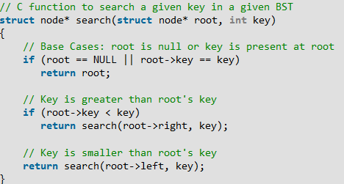
Binary Search Tree (Search and Insertion)

Slide 5
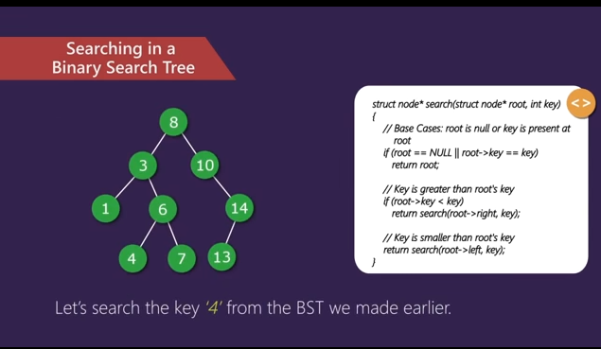
Illustration to search 4 :

Slide 6
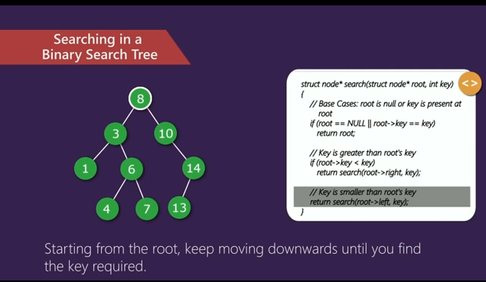
Illustration to search 4 :

Slide 7
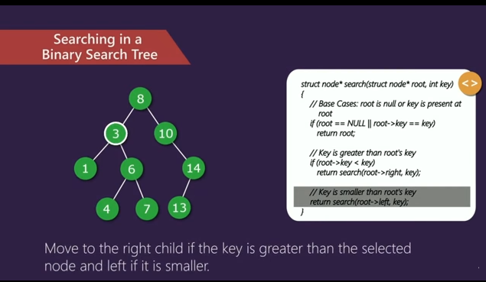
Illustration to search 4 :

Slide 8
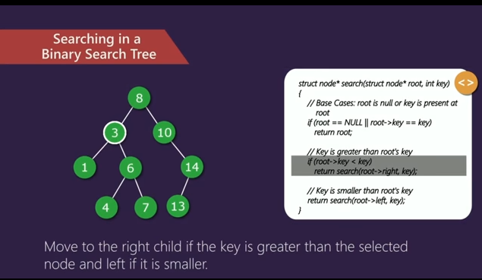
Illustration to search 4 :

Slide 9
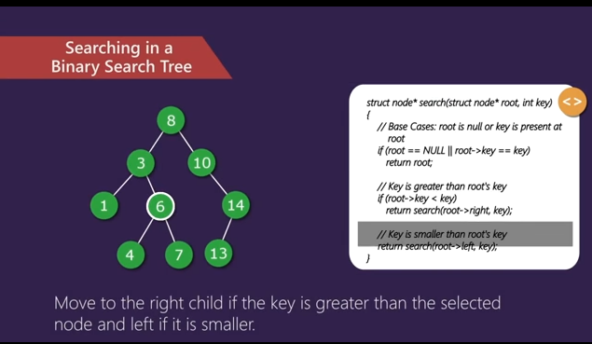
Illustration to search 4 :

Slide 10
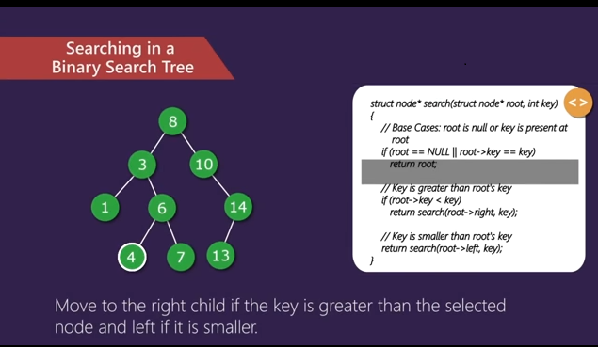
Illustration to search 4 :

Slide 11
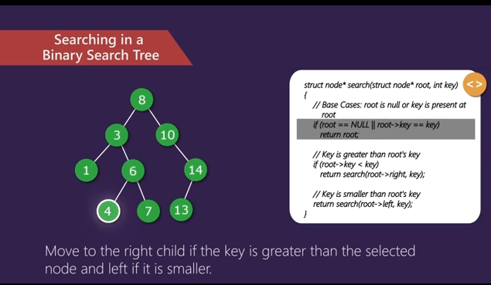
Illustration to search 4 :

Slide 12
Illustration to search 6 :
1. Start from root.
2. Compare the inserting element with root, if less than root, then recurse for left, else recurse for right.
3. If element to search is found anywhere, return true, else return false.
Notes:
The above properties of Binary Search Tree provide an ordering among keys so that the operations like search, minimum and maximum can be done fast. If there is no ordering, then we may have to compare every key to search a given key.

Slide 13
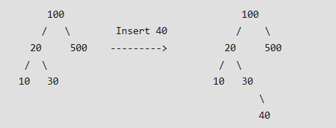
Insertion of a key
While doing insertion in BST the new key is always inserted at leaf
We start searching a key from root to we hit a leaf node
Once a leaf node is found the new node is added as a child of the leaf node

Slide 14
Illustration to insert
1. Start from root.
2. Compare the inserting element with root, if less than root, then recurse for left, else recurse for right.
3. After reaching end, just insert that node at left(if less than current) else right.

Slide 15
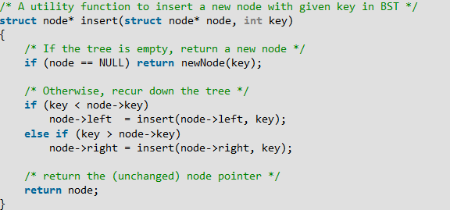
Insertion of a key

Slide 16
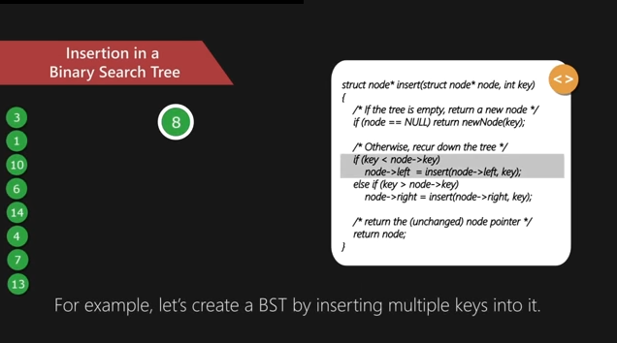
Insertion of a key

Slide 17
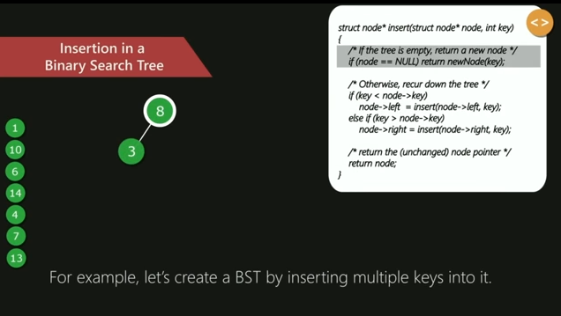
Insertion of a key

Slide 18
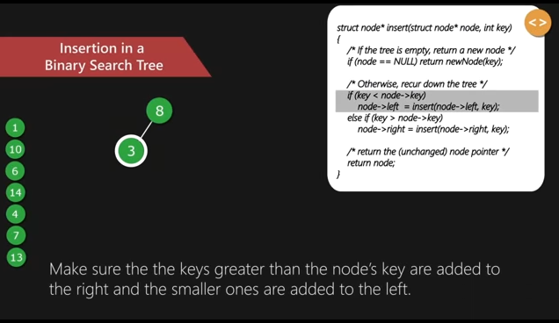
Insertion of a key

Slide 19
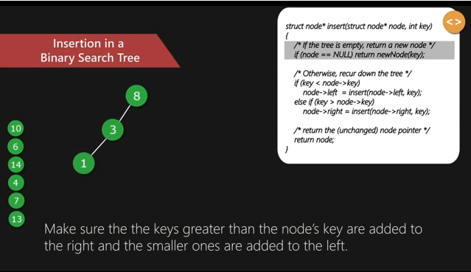
Insertion of a key

Slide 20
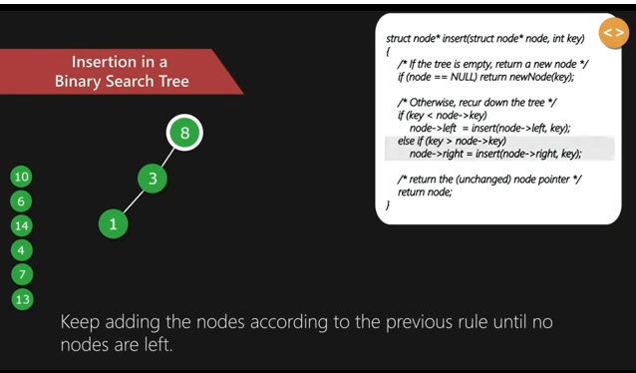
Insertion of a key

Slide 21
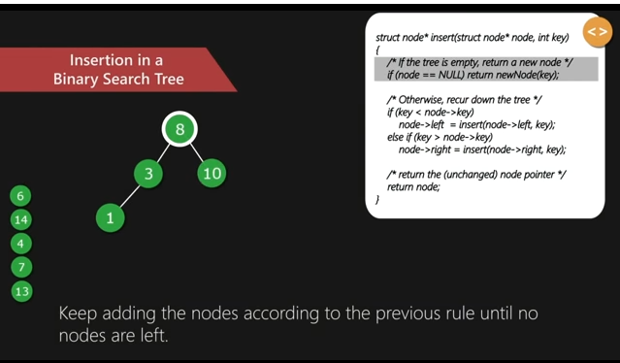
Insertion of a key

Slide 22
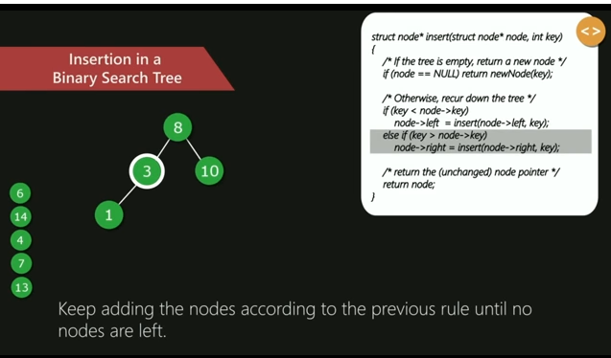
Insertion of a key

Slide 23
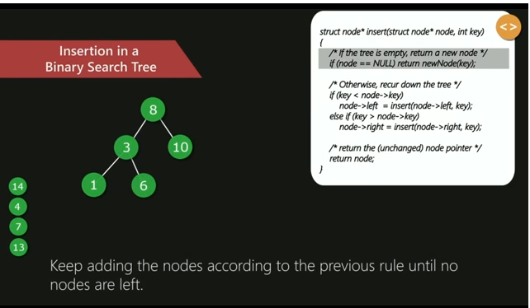
Insertion of a key

Slide 24
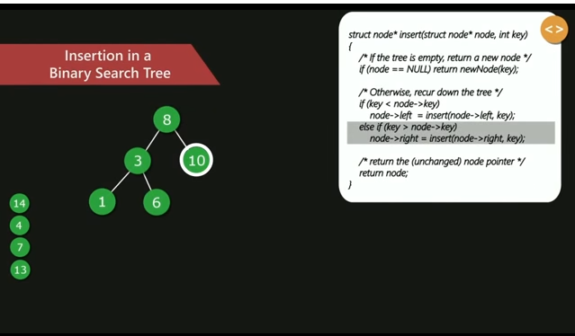
Insertion of a key

Slide 25
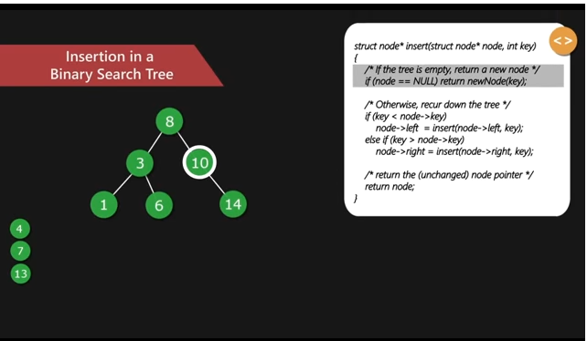
Insertion of a key

Slide 26
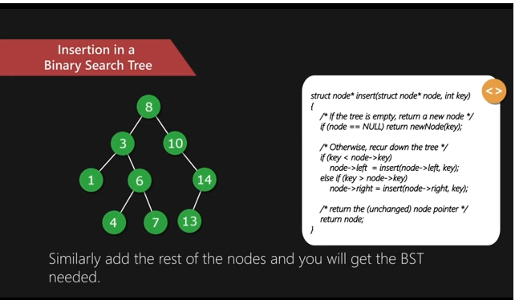
Insertion of a key

Slide 27
Illustration to insert 2 in below tree:
1. Start from root.
2. Compare the inserting element with root, if less than root, then recurse for left, else recurse for right.
3. After reaching end, just insert that node at left(if less than current) else right.

Slide 28
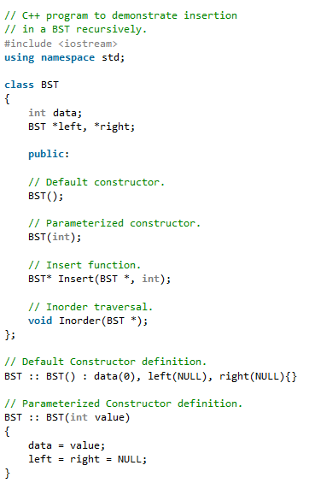
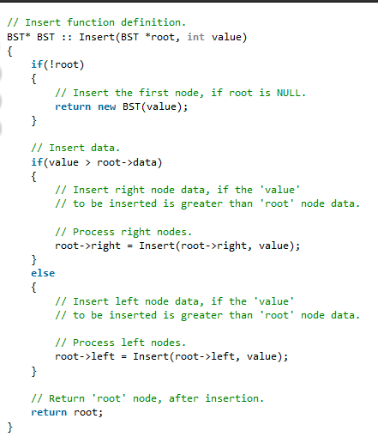
Binary Search Tree Insertion Code in C++

Slide 29
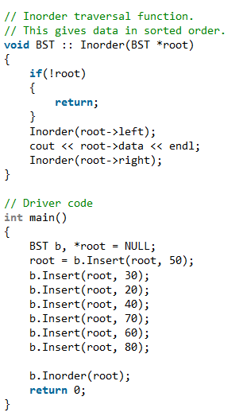
Binary Search Tree Insertion Code in C++

Slide 30
Binary Search Tree (Delete Operation)
Binary Search Tree use a node-based binary tree data structure.
The left subtree of a node contains nodes with keys less than the nodes key and the right subtree with the keys greater than node’s key.
The left and right subtree each must also be a binary search tree and there must be no duplicate nodes
Deletion in BST has been divided in to 3 cases
  Node to be deleted is leaf
  Node to be deleted has only one child
  Node to be deleted has two children

Slide 31
Deletion in a Binary Search Tree
1) Node to be deleted is leaf: Simply remove from the tree.
50 50
/ \ delete(20) / \
30 70 ---------> 30 70
/ \ / \ \ / \
20 40 60 80 40 60 80
2) Node to be deleted has only one child: Copy the child to the node and delete the child
50 50
/ \ delete(30) / \
30 70 ---------> 40 70
\ / \ / \
40 60 80 60 80

Slide 32
Deletion in a Binary Search Tree
3) Node to be deleted has two children: Find inorder successor of the node. Copy contents of the inorder successor to the node and delete the inorder successor. Note that inorder predecessor can also be used.
50 60
/ \ delete(50) / \
40 70 ---------> 40 70
/ \ \
60 80 80
The important thing to note is, inorder successor is needed only when right child is not empty. In this particular case, inorder successor can be obtained by finding the minimum value in right child of the node.

Slide 33
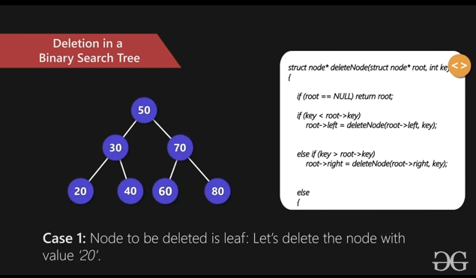

Deletion in a Binary Search Tree

Slide 34
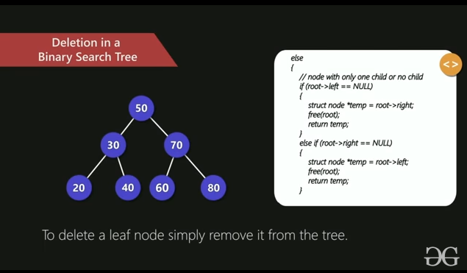
Deletion in a Binary Search Tree

Slide 35
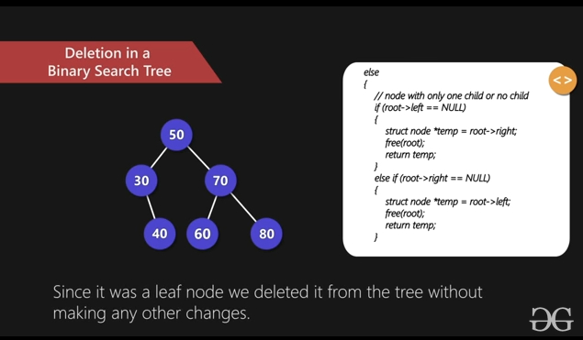
Deletion in a Binary Search Tree

Slide 36
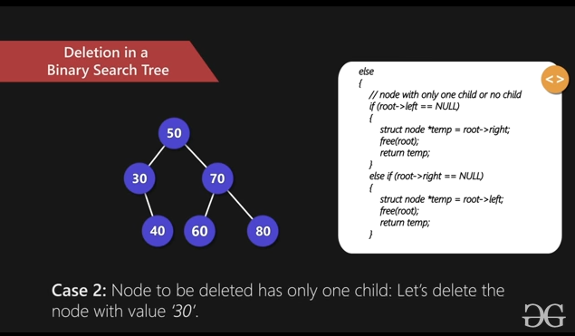
Deletion in a Binary Search Tree

Slide 37
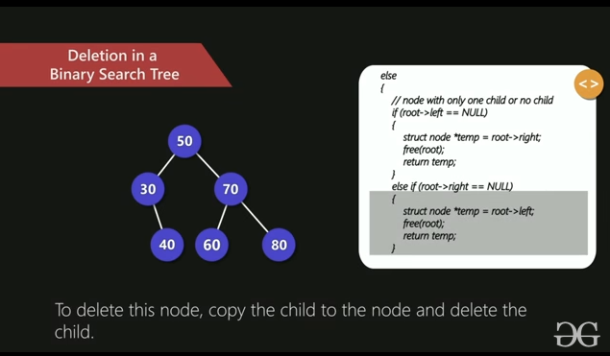
Deletion in a Binary Search Tree

Slide 38
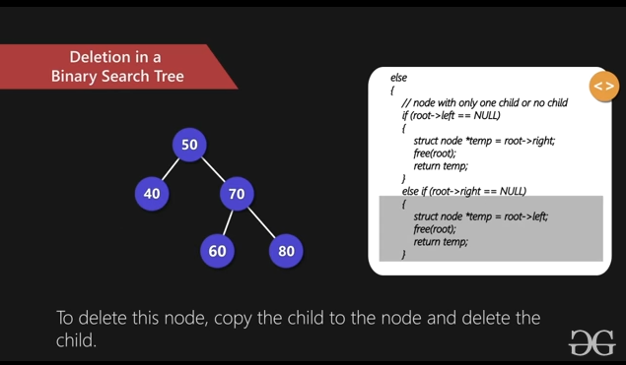
Deletion in a Binary Search Tree

Slide 39
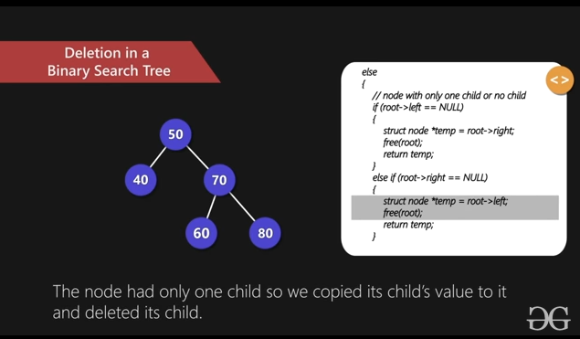
Deletion in a Binary Search Tree

Slide 40

Deletion in a Binary Search Tree

Slide 41
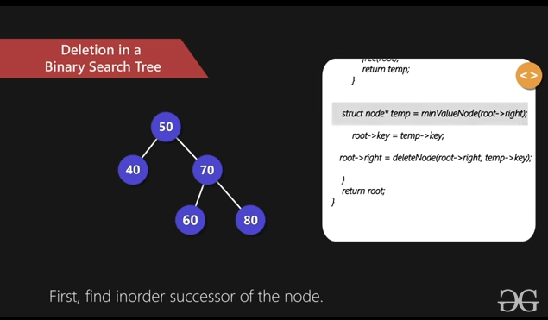
Deletion in a Binary Search Tree

Slide 42
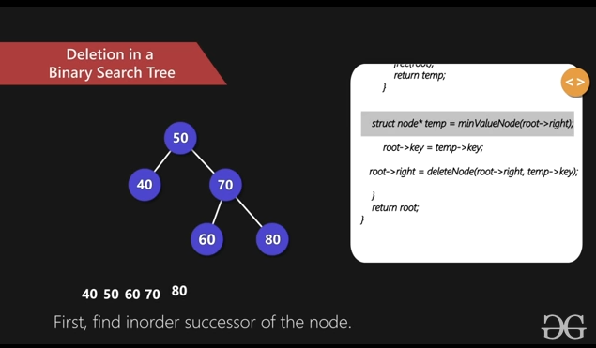
Deletion in a Binary Search Tree

Slide 43
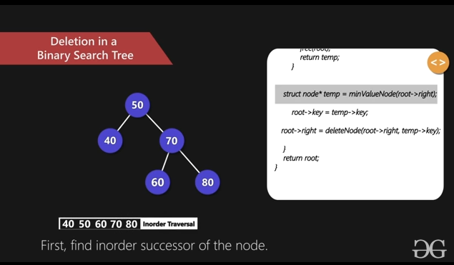
Deletion in a Binary Search Tree

Slide 44
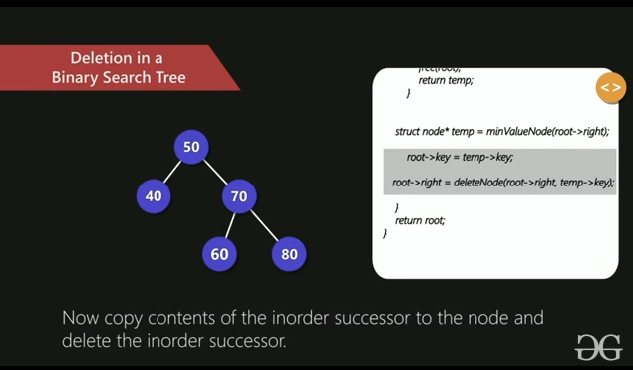
Deletion in a Binary Search Tree

Slide 45
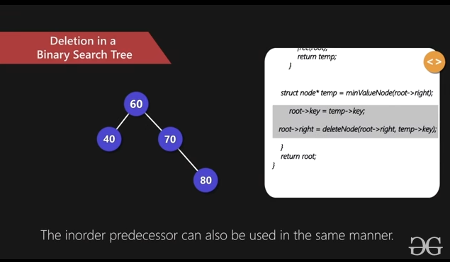
Deletion in a Binary Search Tree

Slide 46
Illustration to delete 32

Slide 47
Illustration to delete 32

Slide 48
Illustration to delete 65

Slide 50
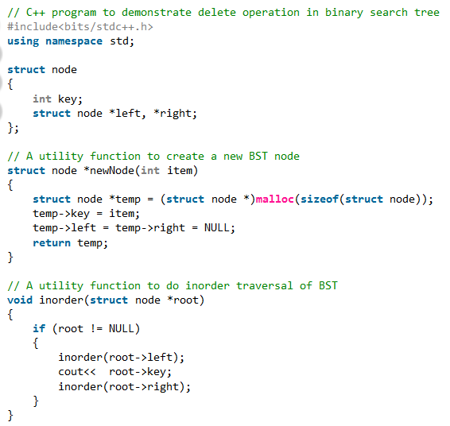
Binary Search Tree Deletion Code in C++

Slide 51
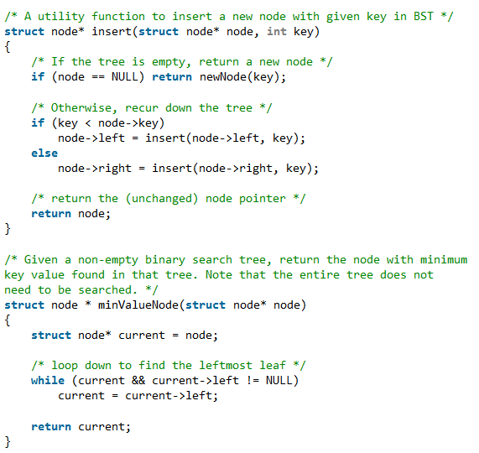

Slide 52
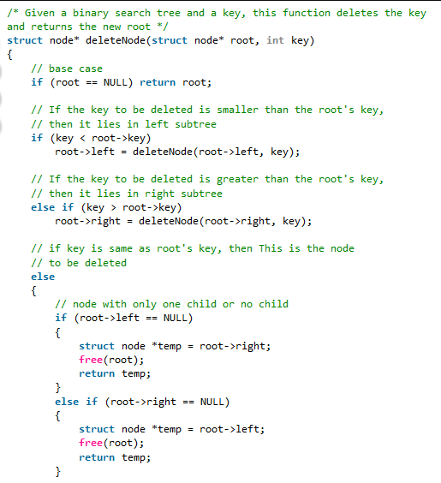

Slide 53
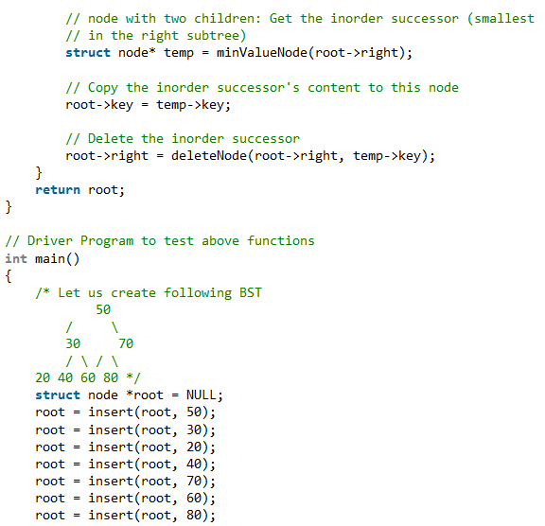
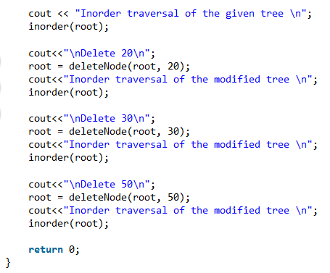

Slide 54
Output
Inorder traversal of the given tree
20 30 40 50 60 70 80
Delete 20
Inorder traversal of the modified tree
30 40 50 60 70 80
Delete 30
Inorder traversal of the modified tree
40 50 60 70 80
Delete 50
Inorder traversal of the modified tree
40 60 70 80

